Slide 1
Assignment 2: Relation Extraction
Web Data Processing Systems Fall 2017
Professor: Jacopo Urbani
Team Members: Nguyen Huu Tung, Felipe Souza, Sara Salimzadeh

Slide 2
What we discuss…
Why relation extraction?
Optimization of first assignment
Procedure to do the idea
Limitation
Live Demo
Future work

Slide 3
Why relation extraction?
Consider different areas such as co-reference solution and question-answering model
Well known subject, many information and resources can be found
Extract structured information from unstructured data
Applications like question answering, mining bio-medical text, extracting relationships among people

Slide 4
Our idea
Perform Relation Extraction on the WARC file used in the 1st Assignment
Necessary steps:
Process all the records from the WARC file
Perform Relation Extraction
Problem: performance

Slide 5
Optimization of first assignment
Investigate the bottleneck for each step of the first assignment
Take a subset of WARC to profile
Try some simple method: count all numbers of records in WARC but Das-4 took 2 minutes to just do this

Slide 6
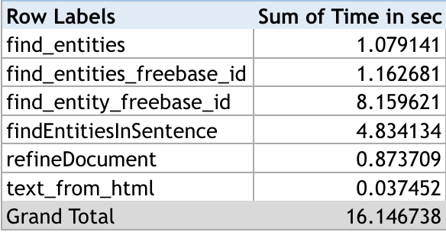
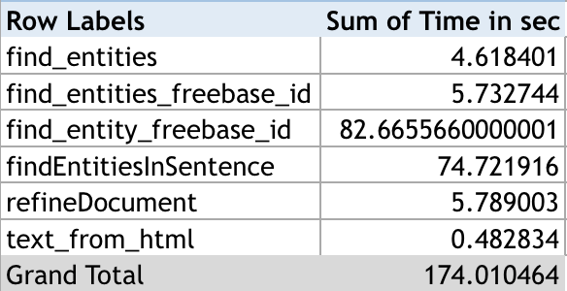
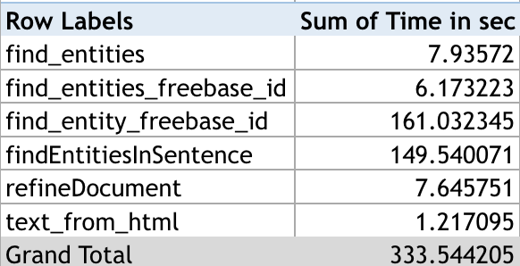
Table of first assignment exec time
Take 20
Take 50
Take 75

Slide 7
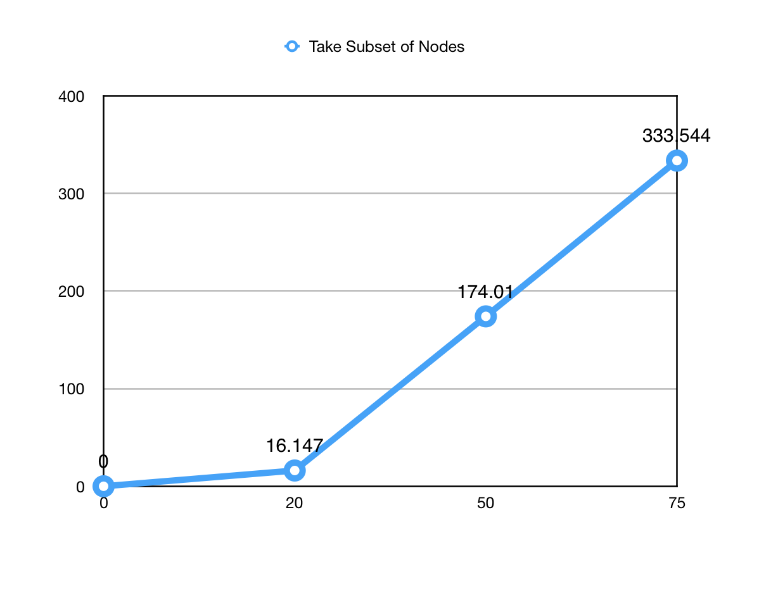
Graph of first assignment exec time (before opt.)
Time (Seconds)
Number of records

Slide 8
Optimization of first assignment
Utilizing the possible resources of DAS-4(Example)
Filter Non-ASCII words (English record only)
Replace Stanford stack with NLTK (For python)
In our test, Stanford stack took 10 seconds for tagging entities in normal sentence while NLTK took only 5 seconds

Slide 9
Relation Extraction
It can be a very complex task:
Supervised approaches require
Complex tools
Training data
Solution:
Use of NLTK for Relation Extraction

Slide 10
Relation Extraction
Optimization:
Problem with setting up the environment to use WARC file
Relation extraction for a sample data set
Splitting the text into sentences using NLTK
Relation Extraction using NLTK

Slide 11
Relation Extraction – cont.
With NLTK it is possible to:
Tokenizing the sentences into words
Specifying the part of speech for each word
For given type of relations list, finding relation (using the corpus : ‘ace’ )
Uses regular expressions to identify the relations
WARC – TOP1000 words x Top 100 English verbs

Slide 12
Building ideas for an application on top of relation extractions
Request- Response model (similar to SQL):
Small subset of sentences instead of WARC files
Running the program locally

Slide 13
Live Demo
Running the code

Slide 14
Limitations on NLTK
Ace training data precision
Requires more than 2 named entity

Slide 15
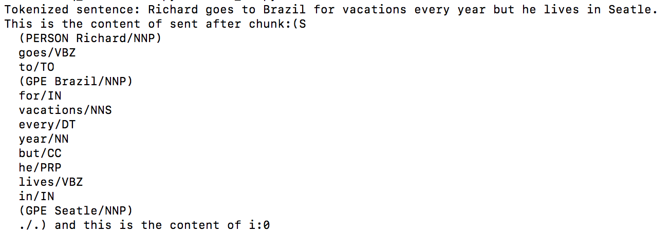
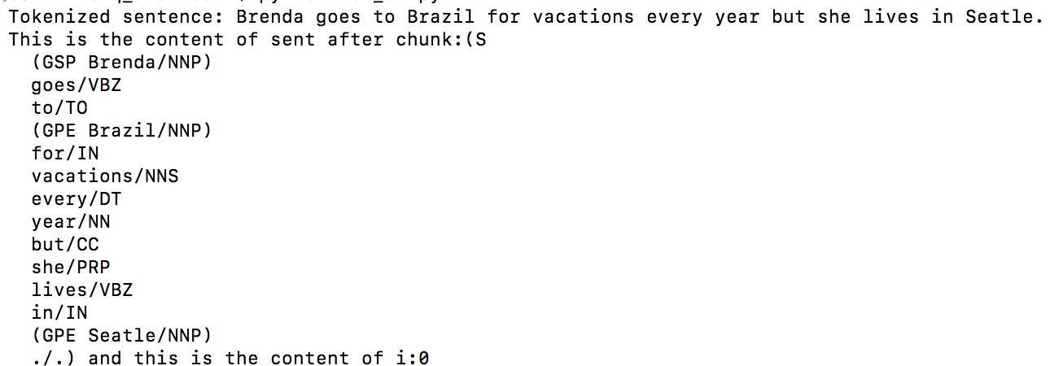
Limitations on NLTK
Misidentifying the female name

Slide 16
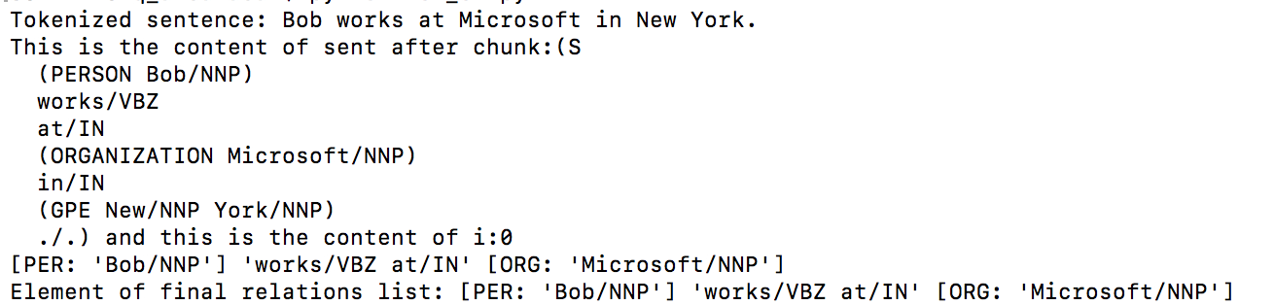
Limitations on NLTK
Unrecognized relation sample

Slide 17
Future work
Making question-answering model
Running the queries against a WARC file with many more sentences

Slide 18
Thank you for your attention

